Slide 1


Chautauqua Lake Reopening
Informational Parent Meeting
Chautauqua Lake
Stronger Together

Slide 2
Zoom Meeting Protocols Dr. Liddell Superintendent
Welcome & Thank You for attending today’s parent meeting!
A friendly reminder to please mute your microphone to reduce background noise.
Please place all questions in the chat. Whenever possible, they will be answered by the appropriate person in live time on the chat function.
If you have a question that requires additional follow up, a member of our leadership team will reach out to you via the email you provided.
Also if you want to have a phone conversation just leave your number in an email to one of leadership team members and request a call.
Our hope and objective is that you leave the meeting feeling informed to make the best decision possible for your family.

Slide 3
Parent Meeting Review Areas
Dr. Liddell jliddell@clake.org
Technology (Derek Svenson Technology Director) dsvenson@clake.org
Health & Safety (Michelle Holley School Nurse) mholley@clake.org
Child Nutrition (Jennifer Shearer Food Service Director) jshearer@clake.org
Facilities (Patrick Quinn K-12 Assistant Principal) pquinn@clake.org
Transportation (Jim Morrison Transportation Director) jmorrison@clake.org
In-Person Learning (Rachel Curtin Secondary Principal) rcurtin@clake.org
Self-Selected Remote Learning (Meg Lundgren Elementary Principal) mlundgren@clake.org
Classrooms & Transitions (R. Curtin, M. Lundgren and J. Liddell)
Social Emotional Learning Supports (Katrina Cummings Psychologist) kcummings@clake.org
Wellness & Attendance (Catherine Rivera School Counselor) crivera@clake.org
Parent Help & Support (Dr. Liddell)
***To limit confusion parent Chat Questions should be in alignment after/during review of these areas

Slide 4
Reopening Committee Members
Thank You!
Student Support Committee Members
Katrina Cummings – Chairperson - School Psychologist
Kristine Stroth – Chairperson - CSE Chairperson / Secondary Special Education Teacher
Jessica Cowan - Secondary School Counselor
Heather Cofer – District Parent / Elementary PTC Member
Michelle Holley - School Nurse
Jennifer McPherson - District Librarian
Amy Webb - Board of Education President / Parent
Operations Committee Members
Jim Morrison - Chairperson - Transportation Director
Patrick Quinn - Chairperson - K-12 Asst. Principal/ Buildings & Grounds Supervisor
Derek Svenson - Director of Technology
Kirstin Harris – Erie 2 BOCES Supervisor
Wendy Rosage - Maintenance Department
Jennifer Shearer - Cafeteria Manager
Jennifer Phillips – Public Relations
Beth Starks – Chautauqua Lake Child Care Center Executive Director
Kathy Siragusa –Chautauqua Lake Child Care Center Program Director
Wellness Committee Members
Catherine Rivera – Chairperson - K-12 School Counselor
Bill Persons – Chairperson - Secondary Teacher
Kara Smith - Elementary School Counselor
Dr. Robert Berke – School Physician
Cole Gleason - Elementary Physical Education Teacher & Coach
Dennie Stahlsmith - District Registrar
Terry Smith - School Nurse
Mary Lee Talbot – Former Board of Education Member and Community Member
Teaching and Learning Members
Megan Lundgren – Chairperson - Elementary Principal
Bryan Bongiovanni – Chairperson - Elementary Teacher
Rachel Curtin - Secondary Principal
Heidi Martin - District Clerk / Superintendent's Secretary
Jackson Janicki & Hailey Roush – Secondary School Students
Jason Richardson - Secondary School Counselor
Brian Binkley - Secondary Teacher
Craig Hindman - Secondary Teacher
Mike Rohlin - Secondary Teacher
Kimberly Siebert - CPSE & CSE Chairperson/ Elementary Teacher
Kimberly Mages -Elementary Teacher
Stephanie Janicki - Parent / Secondary Teacher
Lisa Stonefoot - Erie2 BOCES Staff Development Specialist

Slide 5
Chautauqua Lake Reopening Committee Dr. Liddell
Mission Statement:
The Chautauqua Lake Reopening Committee will focus on the health, safety and well-being of all our PreK-12 students and staff when making reopening decisions. We will work collaboratively to develop creative and effective solutions to ensure educational and social equity. Following NYSED, NYS Department of Health and Federal CDC guidelines we will produce the best possible and safest instructional environment we can with the tools and resources that are available.
*Mitigate risk as much as possible….
2 months of work: June 23rd, July 7th, July 23rd, July 30th, August 13th

Slide 6
Reopening Plan Highlights Dr. Liddell
1:1 Devices for every CL Student K-12 (Educational Equity)
MERV 13 Filters 653 (HVAC Enhancements)
Frontline Health Screening App & Thermal Temperature Scanners (7 Units)
Modern/Larger Building to Help Social Distancing Requirements (Clark Patterson Lee Review)
Instructional & Support Staff Key Contributors to Development Process
Leadership Team Positive Collaboration & Willingness to Work
Board of Education & Community Support
Parent Choice with Educational Model Selection (every family situation is unique):
  Full In-Person Instruction PreK-12
or
  Live Remote Learning
Cautiously Optimistic:
Built-In Ability to Quickly and Efficiently Transition Between Models
Chautauqua Lake Central School District: Stronger Together!

Slide 7
Informational Video Series: Production Dr. Liddell
Videos that Model:
What school will look like in the fall
Getting on the school bus
Coming into the building (temperature check)
  Frontline Health Screening and video explaining the use of thermal scanners in school
  Attendance and Checking in with Homebase Advisors (secondary)
One way hall traffic
Cafeteria
In the classroom
Locker & bathroom
*Developing videos presently and trying to use the new safety related materials and supplies to ensure realism.
Videos that Inform:
Infographic videos animated with screen images from the programs
Back to School for Parents:
  Accessing PowerSchool information
  Remind App/Class Dojo and Communicating with school
  Dropping off and Picking up Students when your child goes home sick
  Monitoring Meal Account balance and adding money
Instructional videos (for teachers and students):
  Zoom rooms
  Self-selected remote learning
  Google Classroom

Slide 8
Technology & Connectivity
Derek Svenson dsvenson@clake.org
Student Chromebook plan for 2020-2021
Grades K-12 will be 1:1 with Chromebooks by start of school
Grades K to 6 carts; grades 7 to 12 protective bags
Spare devices for breakages
System Support / Questions for Teachers, Staff, Students and Parents
External IT support phone number: 716-753-5860 (staffed during work hours)
Frontline, Google Classroom, Remind, ClassDojo
Parents have access to www.clake.org with system training resources
Distance learning (Zoom) online training sessions for teachers and parents

Slide 9
Health & Safety Michelle Holley mholley@clake.org
Prevention Measures to Reduce Exposure
Face Coverings
Hand Hygiene
Social Distance
Health Screenings and Reporting
Temperature Checks at the door
Isolation Room and Wellness Center
Procedures for sending sick students home

Slide 10
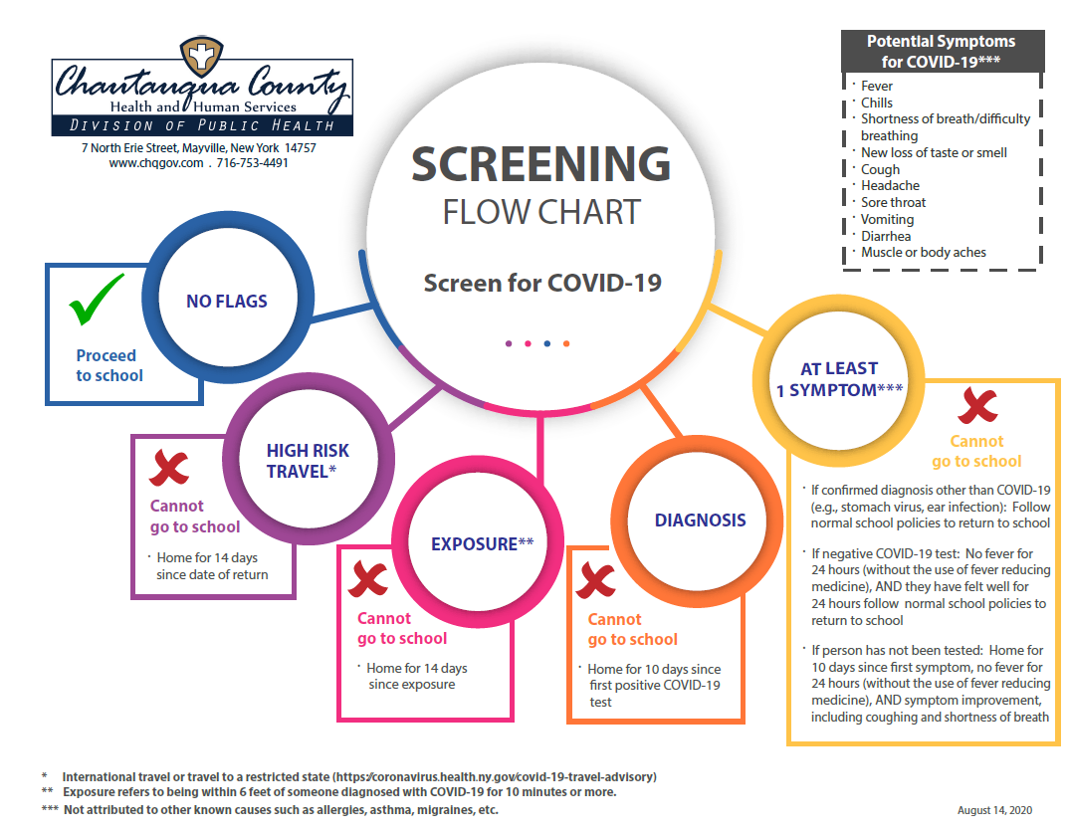

Slide 11
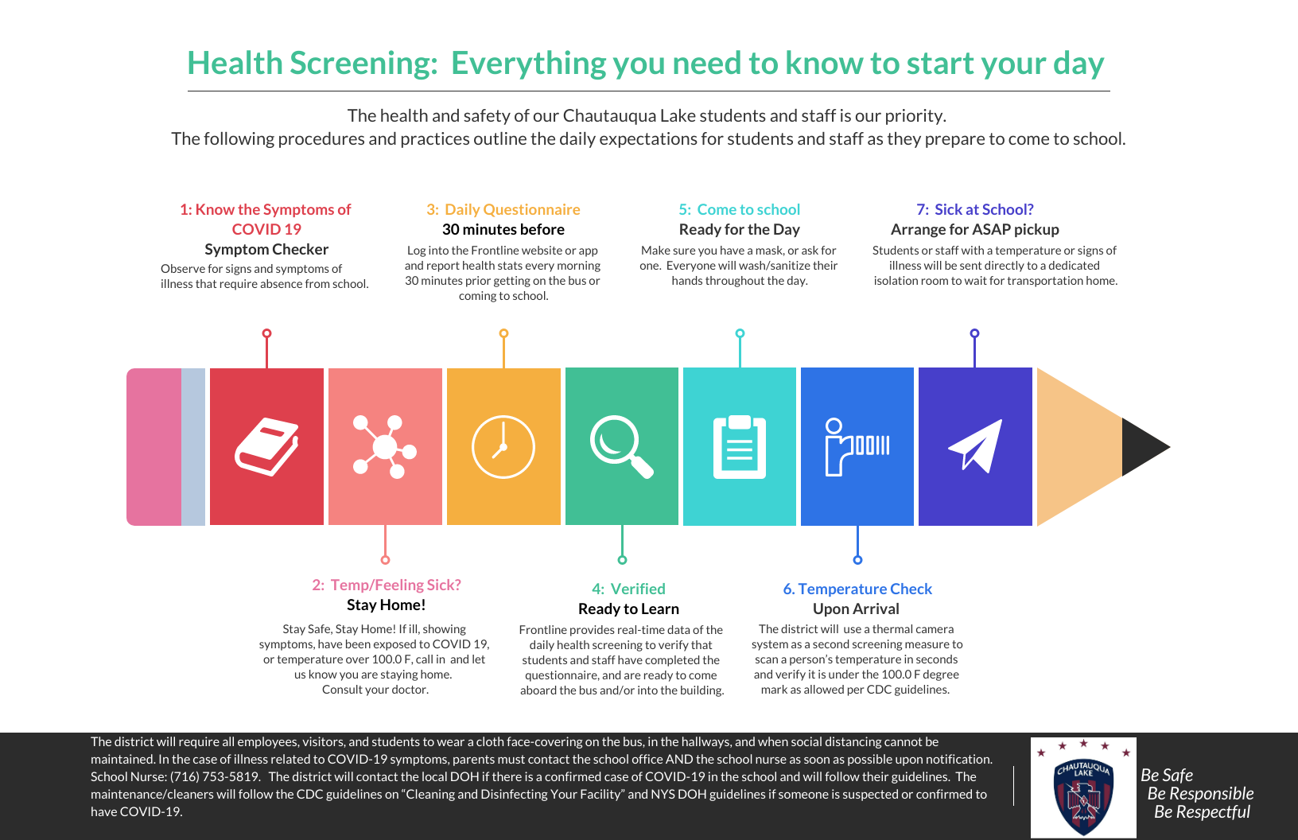

Slide 12
Child Nutrition Jennifer Shearer jshearer@clake.org
All food individually wrapped. No bulk condiments. No “share table.”
No self service in the serving line, all food put on trays by the server.
No “a la carte” to start until we are situated.
No cash accepted by Cashier during meal service. Pre-pay account must be used.
Breakfast cart as kids enter school in 3 locations.
Students will wash hands/sanitize before and after meals.
  Lunch delivered for grades K-2 classrooms, with pre-order form.
  Lunch 3-12 in Cafeterias, HS Gym and Band Room.
    Cohorts kept together
    Tables divided
    Limited kids at each table
All tables/chairs/touch points will be sanitized between groups.
No overlap of groups.

Slide 13
Facilities Patrick Quinn pquinn@clake.org
Water bottle filling stations
The water fountains will be closed; water bottle filling stations added.
Currently have 2 at secondary and 4 more will be installed.
K-6 sinks in classroom for bottle filling
Signage
Social distancing and directional signage will be placed throughout the buildings on the floor, walls, and strategic locations.
Cleaning & Partitioning
A schedule has been created to provide disinfection of all the high touch surfaces in the building.’
Plastic partitioning will be installed for all office locations in the elementary building, HS office, HS guidance and Cafeteria (cafeteria lines & tables).
All B&G staff members have been trained in the proper cleaning and disinfecting of the building.

Slide 14
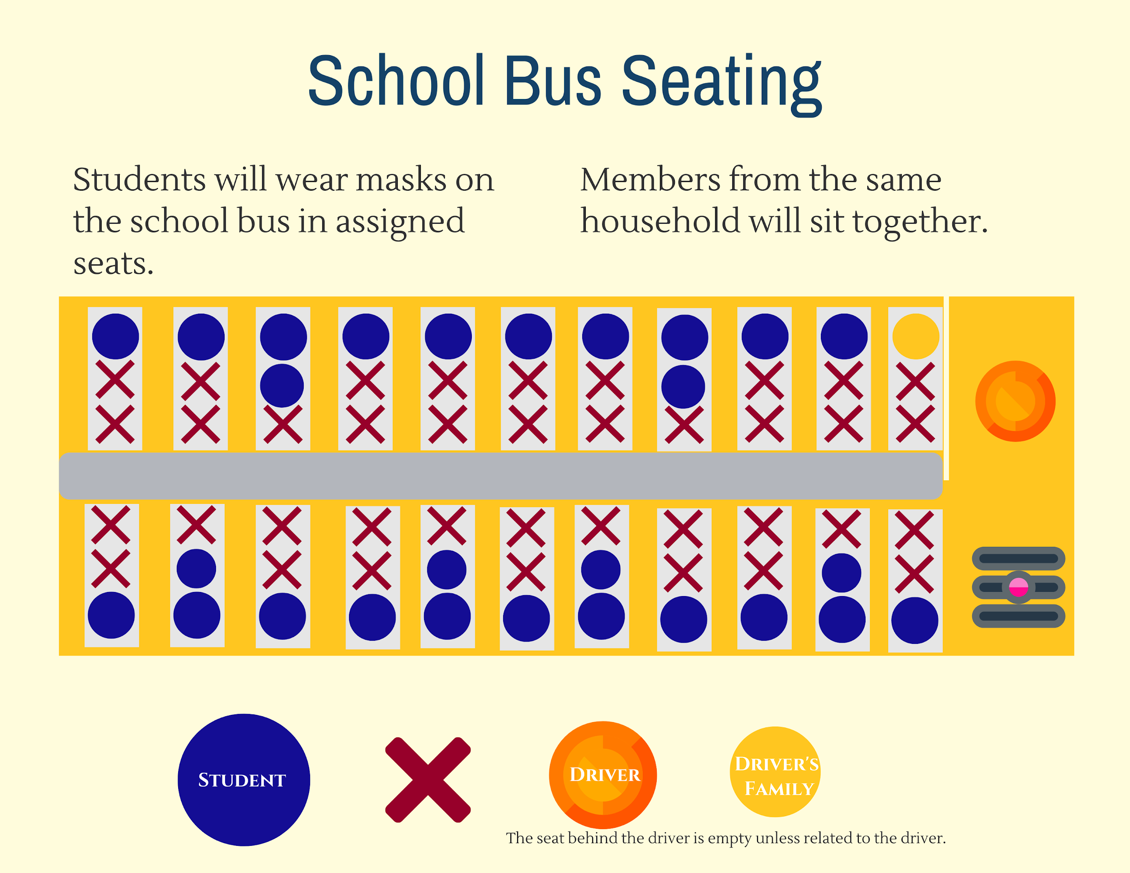

Slide 15
Transportation Jim Morrison jmorrison@clake.org
Seating 1 per seat unless students are from the same household
Students have assigned seating
Staggered loading and unloading at school entrances
1 pick up and drop off location
Bus disinfection and cleaning procedures after each use
Addition of 2-3 am/pm runs to accommodate reduced bus seating

Slide 16
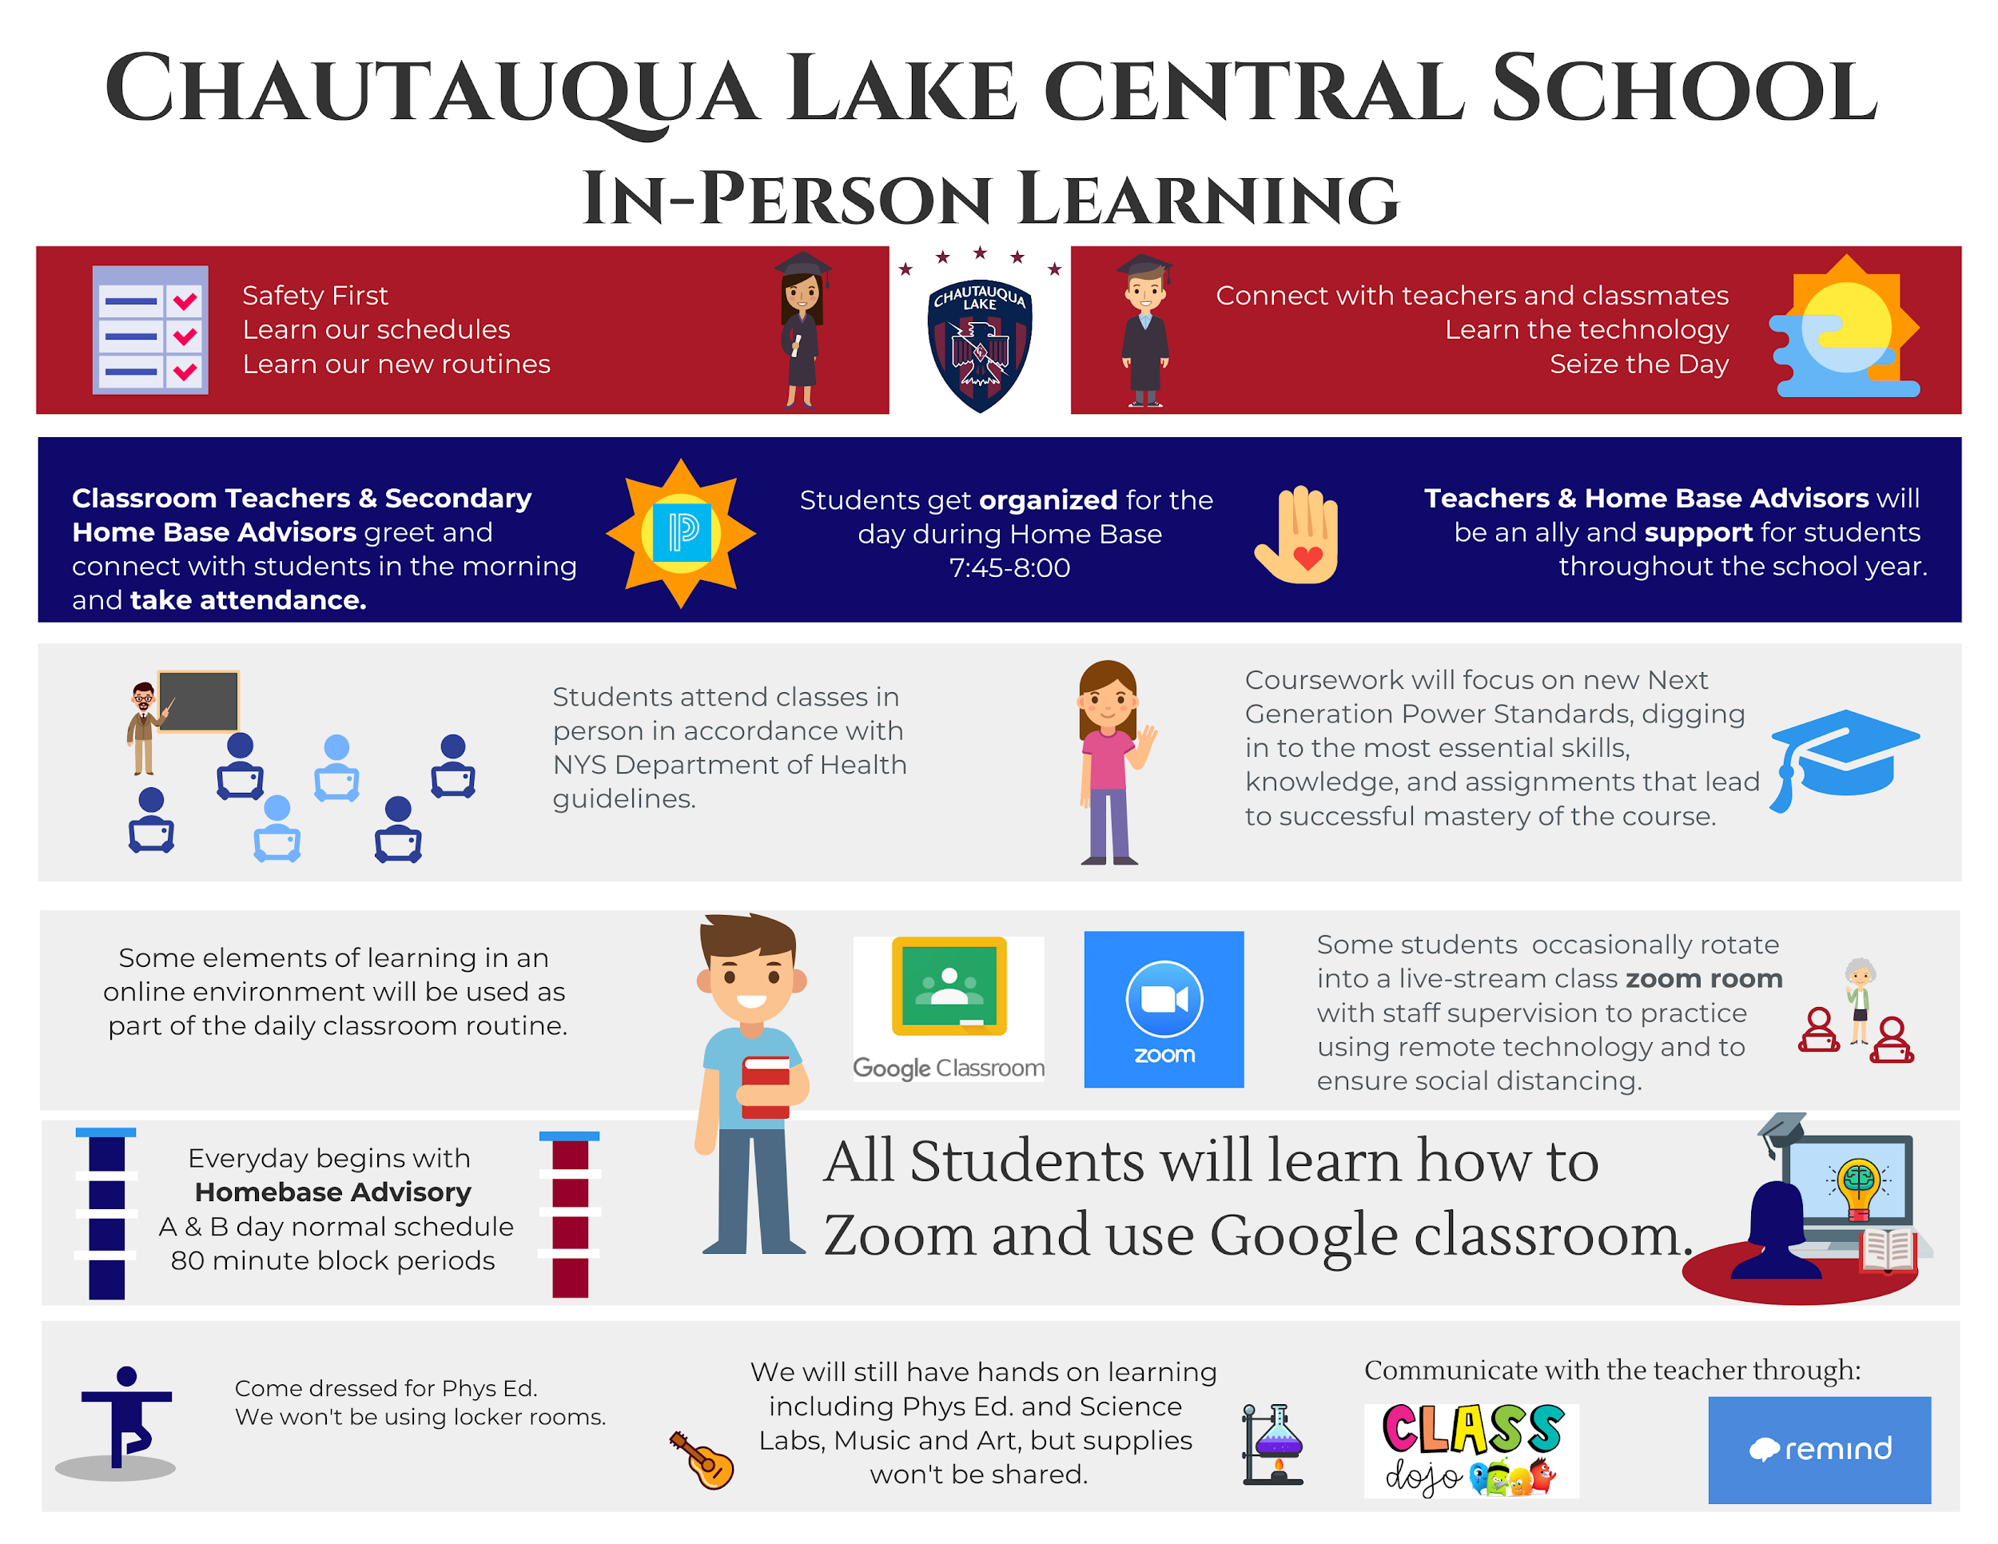
RC

Slide 17
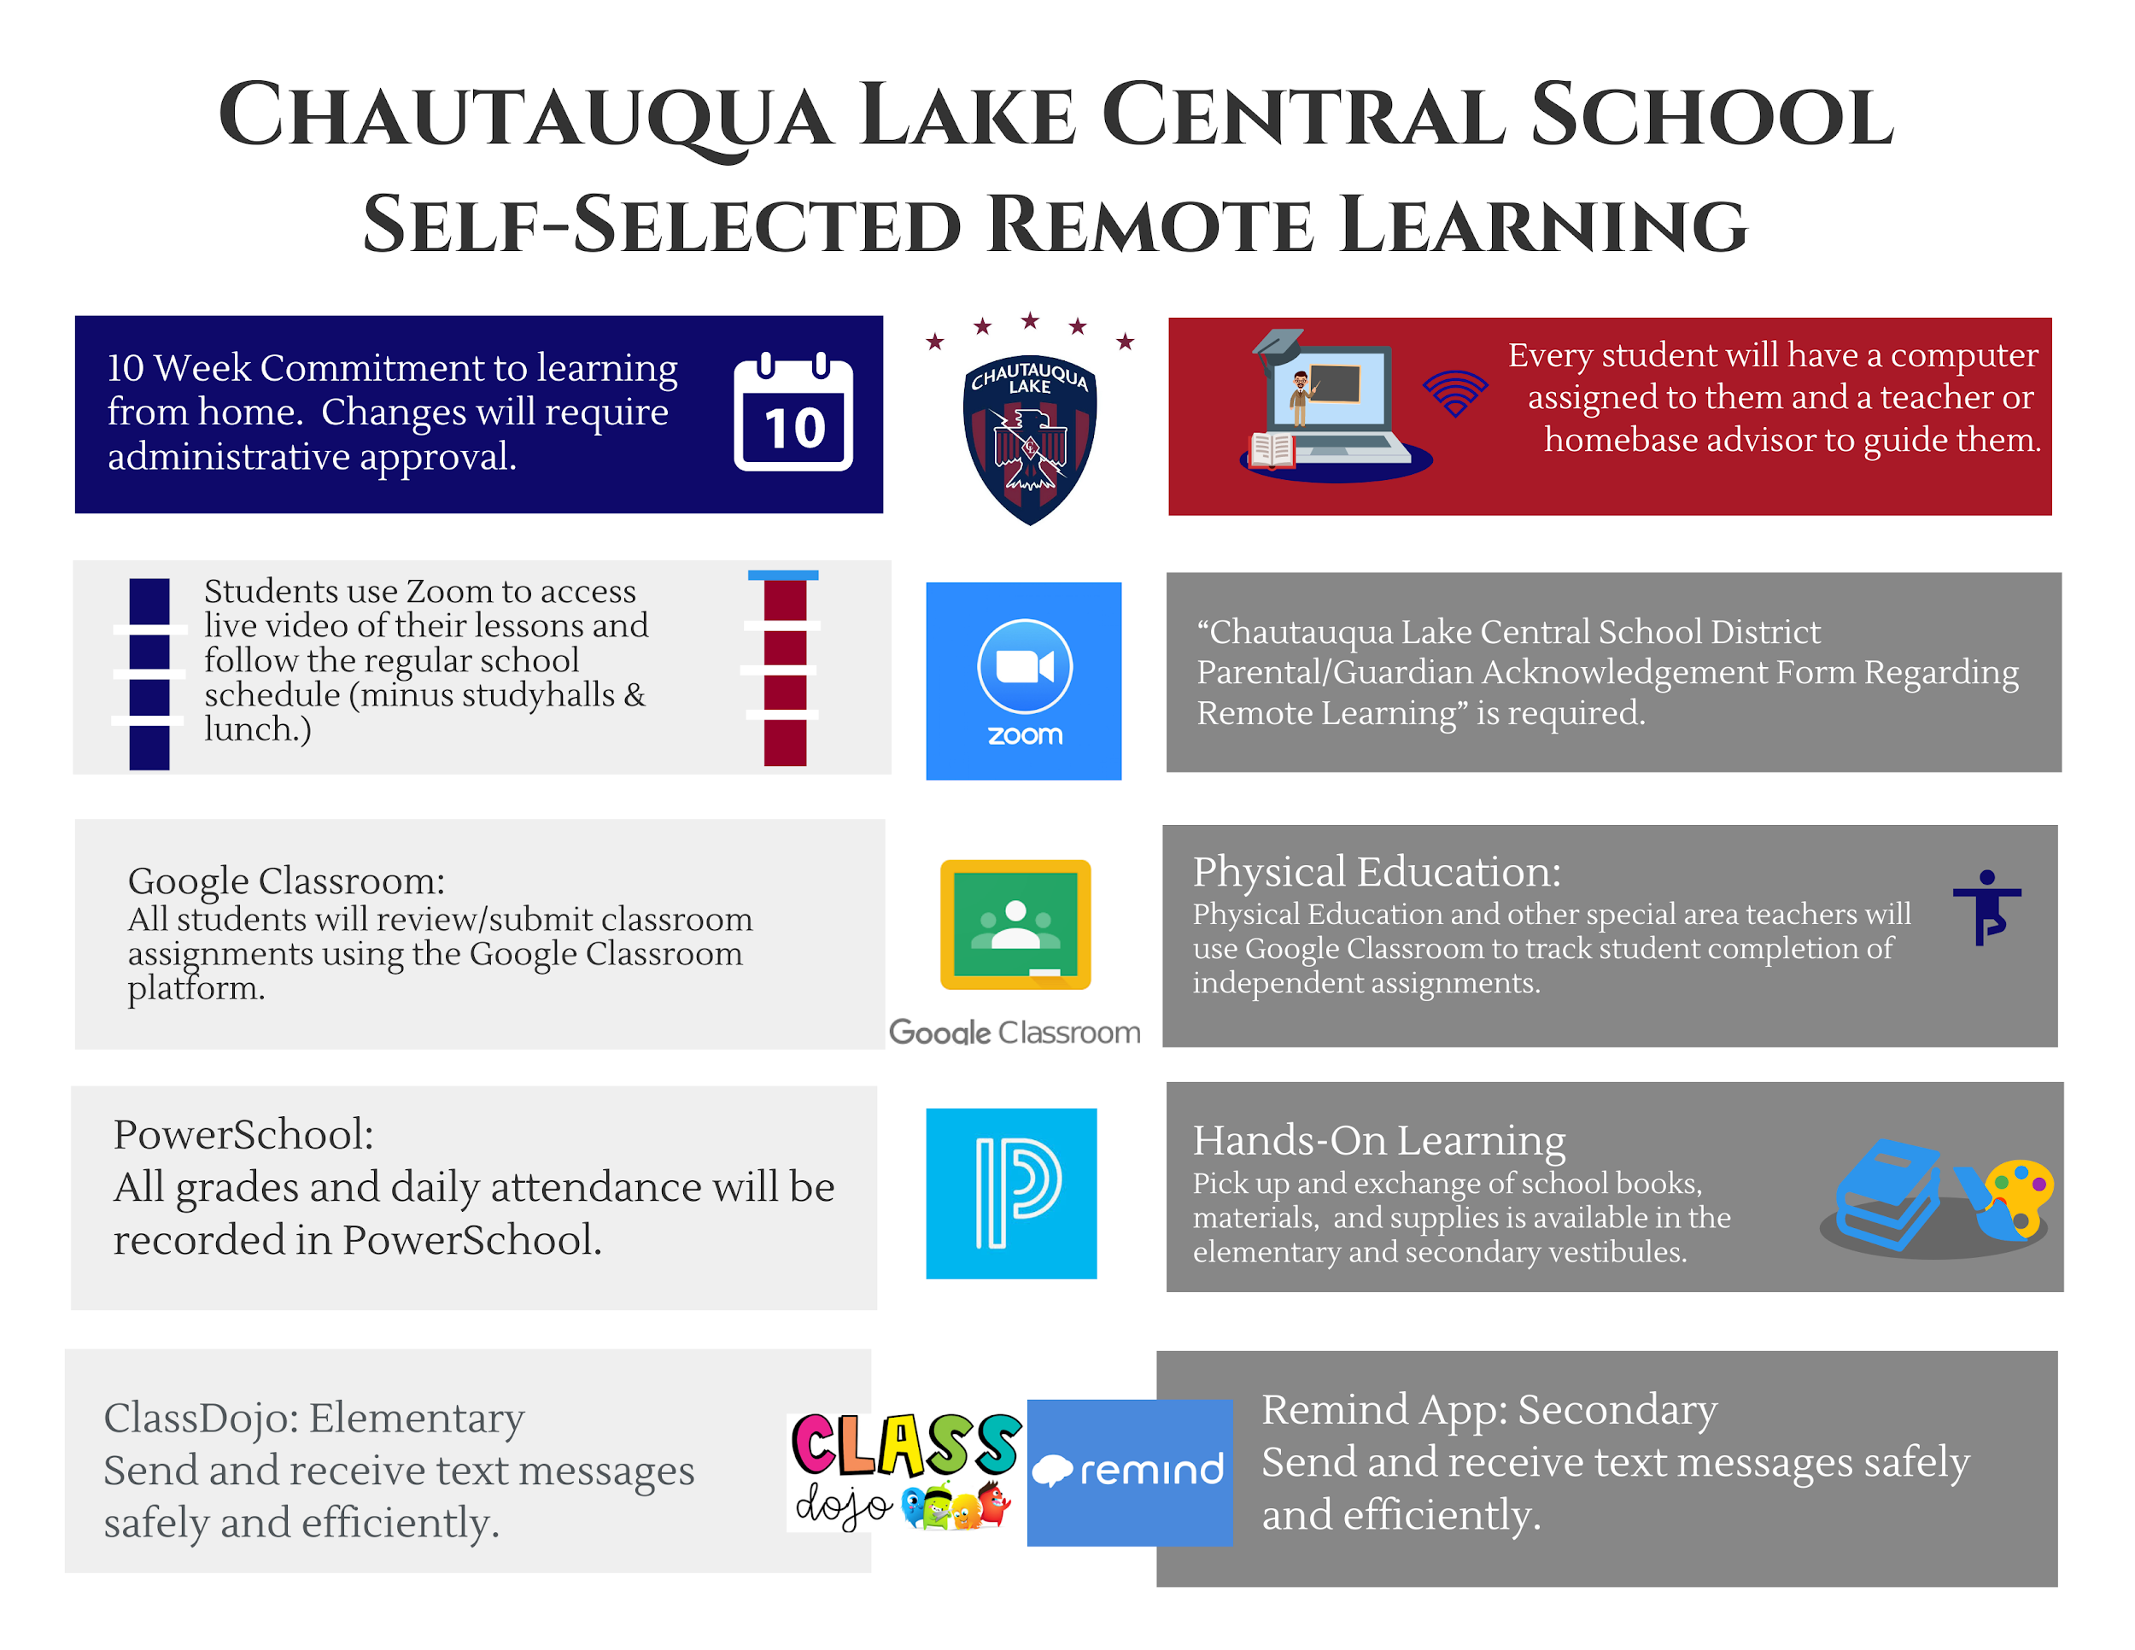
ML

Slide 18
Classrooms & Transitions Rachel Curtin & Meg Lundgren
rcurtin@clake.org mlundgren@clake.org
Elementary
Students will use socially distant traffic patterns and face coverings in the hallways.
Hallway traffic will be minimized.
Content area teachers will travel to students for instructional blocks.
Special areas will alternate between their classrooms, gen ed classroom push-in, and outdoor spaces.
Locker access will be minimal and staggered within classrooms and grade levels.
Secondary
Students transition in the halls with socially distant traffic pattern and face coverings.
Locker access will be part of a student’s regular schedule, and not during hall transitions. Locker assignments are based on this schedule, and students are separated by 6 feet from one another during their scheduled locker time.
Changes in room assignments for faculty will keep most 7th & 8th grade transitions and classes separate from 9-12 transitions and classes.
Strategic scheduling may have some students may remain in a classroom over two blocks.

Slide 19
2 Feet Walking lane
Single File line, Face Coverings on, No locker stops
 |  |  |  | 6 feet | of | space
2 Feet Walking lane
Map of School Showing Hallway Traffic Flow Rachel Curtin

Slide 20
Social Emotional Learning / Behavior Supports
Katrina Cummings kcummings@clake.org
District-Wide Supports
Positive Behavioral Interventions & Supports (PBIS)
Character Education
Student Association
Instructional Support Team (IST)
Attendance Committees
Weekly Counseling Team Meetings
Second Step (PreK-8th)
Sources of Strength (SOS - 6th-12th)
Panorama Student Self-report Survey (3rd-12th)
Fastbridge Self-Report and Teacher Surveys
Check In / Check Out (CICO)
Counselor Check In/Student Meetings
Conflict Resolution
Peer Mentoring
Behavioral Screening Reports
School Counseling Therapy Services (FS, CCMH, CLCS)
504 Counseling
Threat/Safety Assessment Procedures
Outside Agency Mental Health Screening & Potential Intake
Student Safety Plan
CSE Referral & IEP Counseling
Functional Behavior Assessment
Behavior Intervention Plan

Slide 21
Wellness and Attendance Catherine Rivera
crivera@clake.org
Wellness
Student and Staff will be offered training as available through community partners such as:
Mental health first aid training for students
Trauma informed training for staff
Sources of Strength offered at both Elementary and Secondary levels
Safe and healthy activities will be offered, utilizing natural resources available on campus while practicing social distancing guidelines.
Attendance
Attendance will be addressed on an individual basis
Emphasis on potential academic consequences of loss of instructional time
Interventions will be put in place as needed, depending on the student/ family needs utilizing the Attendance Intervention Model

Slide 22
Parent Help and Support Dr. Liddell
Transportation (if possible)
Frontline wellness screening 30 minutes before bus pick-up or arrival at school
Comfortable masks that fit well (school will provide masks if needed)
Instructional model selection by this Friday
Continued questions & suggestions (email any of our focus area leaders)
Flexibility & understanding
First Day of School Wednesday, September 9th

Slide 23

Chautauqua Lake
Stronger Together
A sincere “thank you”
for your continued support….

